Slide 1
Viruses
Dr. Sonal Mishra

Slide 2
Are Viruses Living or Non-living?
Viruses are both and neither
They have some properties of life but not others
For example, viruses can be killed, even crystallized like table salt
However, they can’t maintain a constant internal state (homeostasis).

Slide 3
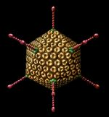
What are Viruses?
A virus is a non-cellular particle made up of genetic material and protein that can invade living cells.

Slide 4
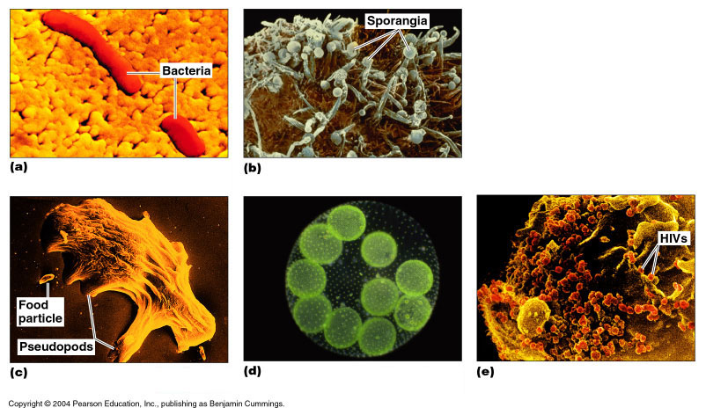
What are Viruses
A virus is a non-cellular particle made up of genetic material and protein that can invade living cells
Latin- POISON
They are little more than pieces of genetic material protected by protein coats.
Parasitic obligat

Slide 5
Introduction
•Viruses: infectious agents that are too small to be seen by light microscope & are not cells.
–They have no cell nucleus, organelles or cytoplasm.
– Louis Pasteur first proposed the term virus.
–Prokaryotes & eukaryotes have DNA & RNA, virus particles contain only one kind of nucleic acid DNA or RNA (never both).
•They display properties of living organism only when they invade host cells.
–Viruses replicate only inside living host; i.e. obligate intracellular parasites.
–Viruses don’t grow or replicate alone, they infect host cell & program it to synthesize the components of new viruses.
•The virus infection may have little or no effect on the host cell or may result in cell damage or death.

Slide 6
Introduction
Viruses differ from cells in important ways:
  Prokaryotic and eukaryotic cells contain both DNA and RNA, individual virus particles contain only one kind of nucleic acid.
  Cells grow and divide, but viruses do neither.
  Viral replication requires that a virus particle to infect a cell and program the host cell’s machinery to synthesize the components required for the assembly of new virus particles.
  Do not possess genetic information for energy-producing systems.

Slide 7
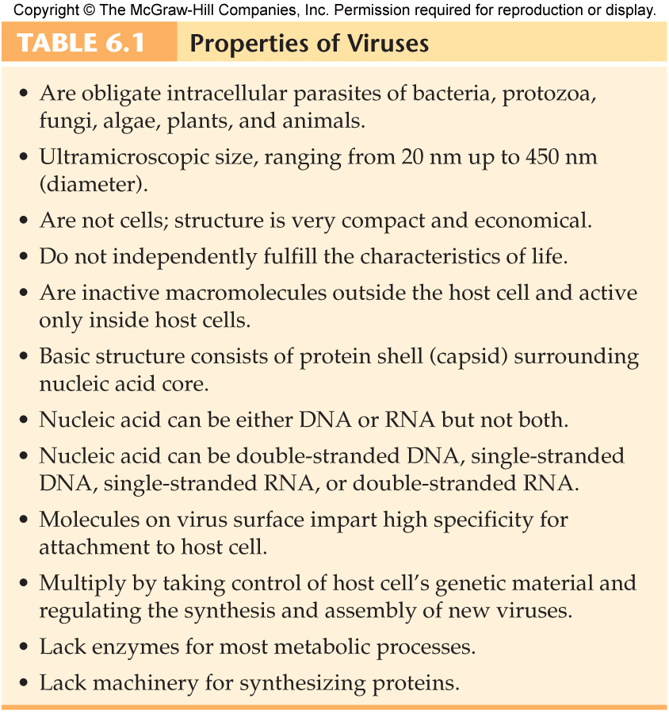

Slide 8

Dead or Alive?
NON-LIVING Particles that have characteristics of LIVING --- They
DO Mutate and Recombine, do not grow/reproduce
Because they are parasites, they can not survive and thrive without a host or group of host cells. The hosts provide viruses with all the chemicals and molecules they need to survive and reproduce.
Viruses can lie dormant within any host or environment until the proper conditions for their activity are provided. Some viruses are also classified as 'persistent viruses'. Such viruses can enter and exit host cells without killing them.
each different virus is stimulated by different conditions and they all have different, specific functions they affect in their host.

Slide 9
Viruses vs. Bacteria
Electron microscope
500 times smaller than bacteria=5 - 350 nm = 1/10th a R.B.C.
parasitic, dependent
cause disease
Ordinary light microscope
1-10 microns
can survive without help from any other living thing
rarely cause disease

Slide 10
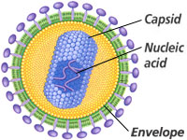
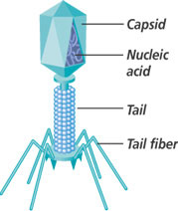
What is a Virus? 4C
Cannot reproduce without a host
Capsid head filled with DNA or RNA
Covered in a sticky glycoprotein coat for specific attachment to host cell site
Shapes of viruses

Slide 11
Viral History

Slide 12
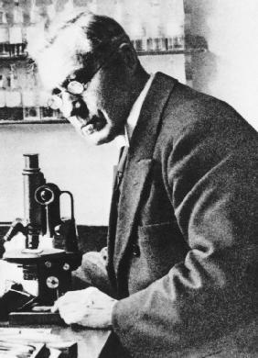
Discovery of Viruses
Beijerinck (1897) coined the Latin name “virus” meaning poison
He studied filtered plant juices & found they caused healthy plants to become sick

Slide 13
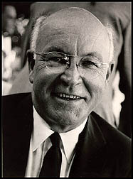
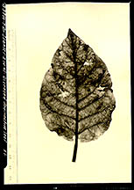
Tobacco Mosaic Virus
Wendell Stanley (1935) crystallized sap from sick tobacco plants
He discovered viruses were made of nucleic acid and protein

Slide 14
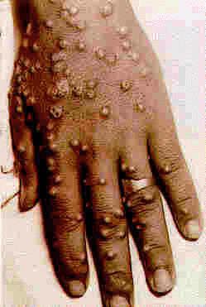
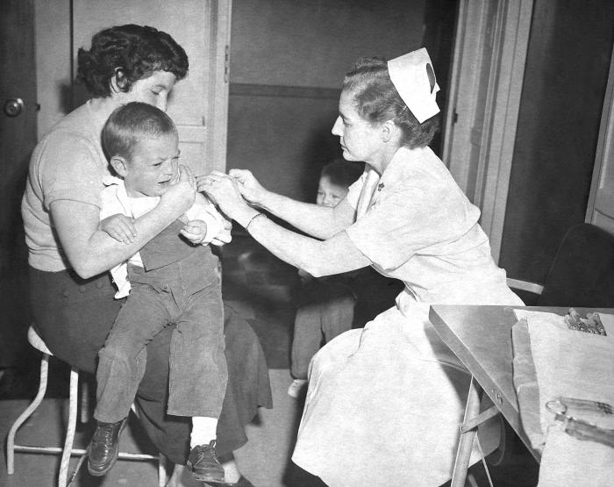
Smallpox
Edward Jenner (1796) developed a smallpox vaccine using milder cowpox viruses
Deadly viruses are said to be virulent
Smallpox has been eradicated in the world today

Slide 15
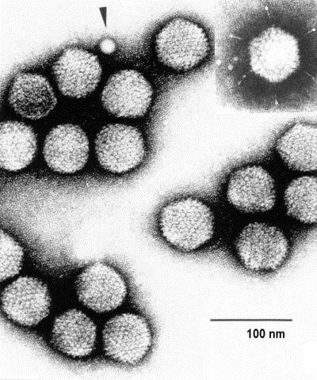
Viewing Viruses
Viruses are smaller than the smallest cell
Measured in nanometers
Viruses couldn’t be seen until the electron microscope was invented in the 20th century

Slide 16
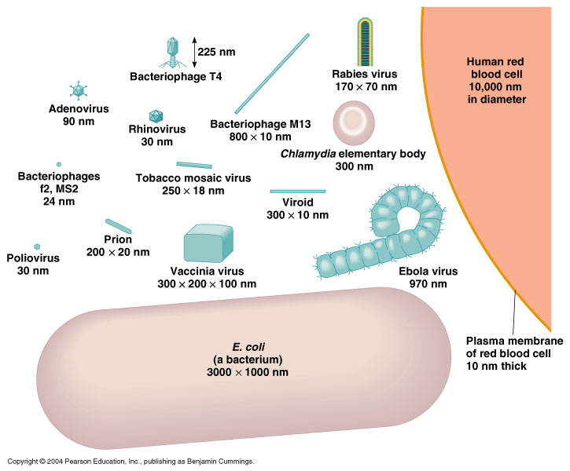
Size of Viruses

Slide 17
Size Range
Smallest infectious agents.
Most are so small, they can only be seen with an electron microscope.
Animal viruses
  Proviruses- around 20 nm in diameter.
  Mimiviruses- up to 450 nm in length.
Viewing viruses:
  Special stains and an electron microscope.
  Negative staining outlines the shape.
  Positive staining shows internal details.
  Shadow casting technique.

Slide 18
Components of Viruses
•Viruses are made up, mainly, of a nucleic acid core surrounded by a protein coat called capsid; together they form a nucleocapsid.
•In some viruses the nucleocapsid is also surrounded by a lipid envelope; which is a lipid-containing membrane.
–A complete virus particle, composed of the abovementioned components is called a ‘virion’.
•Nucleic acids
–Lie in the core of virus
–Viral genome (genetic material) is either:
DNA or RNA
Single stranded or double stranded,
Linear, circular or segmented
–Size of the viral genome:
•DNA: ~3 kb to more than 300 kb
•RNA: ~4 kb to 32 kb

Slide 19
Components of Viruses
•Capsid:
–The protein capsid is an essential component in any virus.
–Viral capsid is composed of protein subunits called ‘capsomeres’.
•Viral capsomere may have either single type of proteins or several different proteins.
•Number, type and arrangement of capsomeres are characteristic for each virus.
–Functions of viral proteins:
Protect the viral genome.
Provide the structural symmetry (shape) of the virus particle.
Participate in the attachment of the virus particle to the host cell.
Determine the antigenic characteristics of the virus.
–Some viruses also carry protein enzymes which are essential for the initiation of the viral replicative cycle.

Slide 20
Components of Viruses
•Envelope
–Enveloped viruses have a lipid bilayer membrane outside their capsid.
–The envelop is acquired after the virus is assembled in a host as it buds or move through host cell membranes.
–Viruses with a nucleocapsid (viral genome & capsid) but without an envelope are called naked or non-enveloped viruses.
–Composition of an envelope is determined by viral genome & by the substances derived from host membranes.
– Mainly a combination of lipids, proteins & carbohydrates.
–Some viruses have spikes on their envelope which are glycoprotein projections that may extend outside the envelope.
•They serve to attach the virions to host cell receptors.
•Determine the antigenic characteristics of the enveloped viruses.
•Some spikes cause RBCs to clump (hemagglutination), a property used to identify viruses.

Slide 21
Components of Viruses
•Envelope
–Advantages:
Because derived from host cell membrane, virus can be hidden from attack by host immune system.
Help virus infect new cells by fusion of envelope with host cell membrane.
–Disadvantages:
Enveloped viruses are damaged easily by any environmental condition that destroys biological membranes.
e.g. elevated temperature, freezing & thawing, pH below 6 or above 8, lipid solvents and some chemical disinfectants.

Slide 22
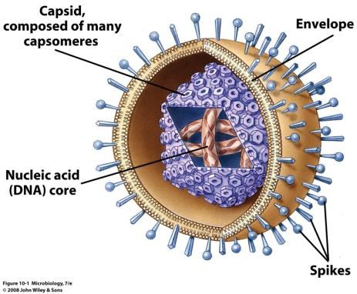
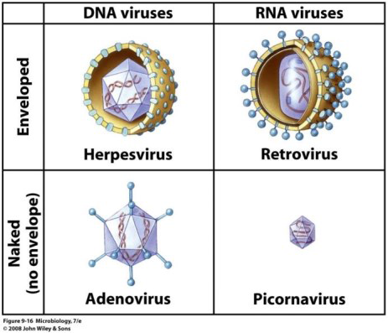
Components of Viruses

Slide 23
Size and Shape of Viruses
•Viruses have range of sizes, the smallest being below 30nm while the largest is more than 300nm (10th of a human RBC).
•Most viruses have specific shape determined by their capsid or envelope:
–Viruses with an envelope have almost spherical shape.
1. Helical capsid: composed of ribbon like protein forms a spiral around the nucleic acid.
2. Polyhedral capsid: many-sided.
  •Icosahedral (20 triangular faces with 12 evenly spaced corners) is one of the most common.
3. Complex capsid: more complicated capsid such as combination of helical & icosahedral capsids.
•Complex viruses have more elaborate coat or capsid, e.g. bacteriophages have special structures like head, tail & tail fibers.

